Slide 1
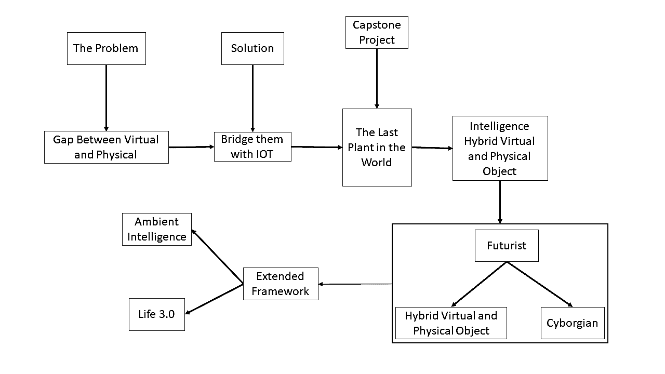
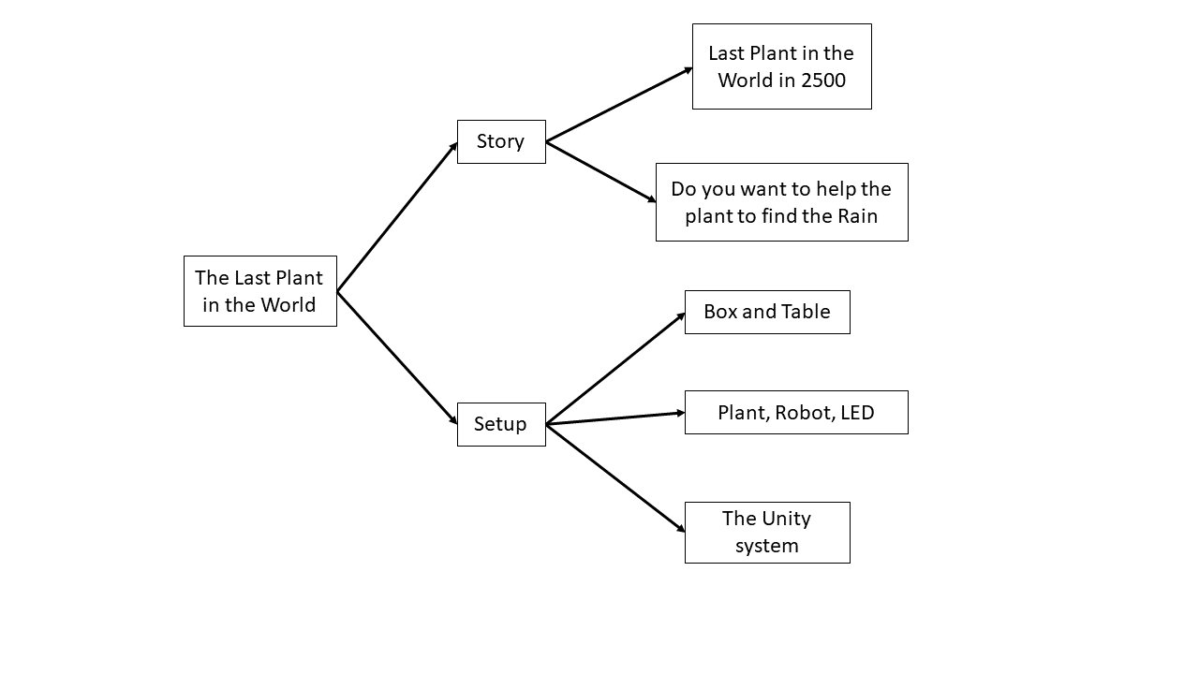
What’s the Problem
Design Pain Point
description
Icons + sketches

Slide 2
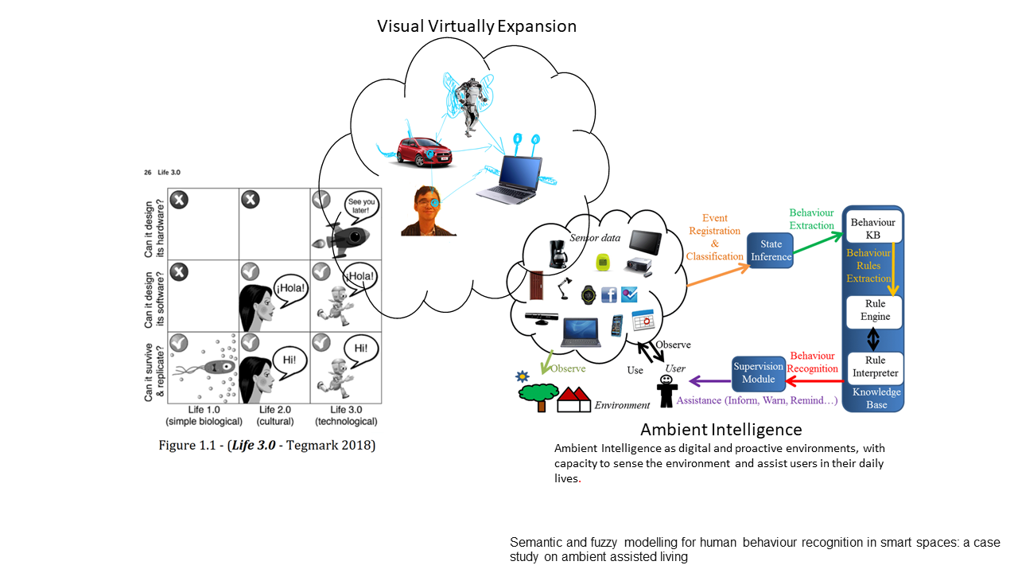
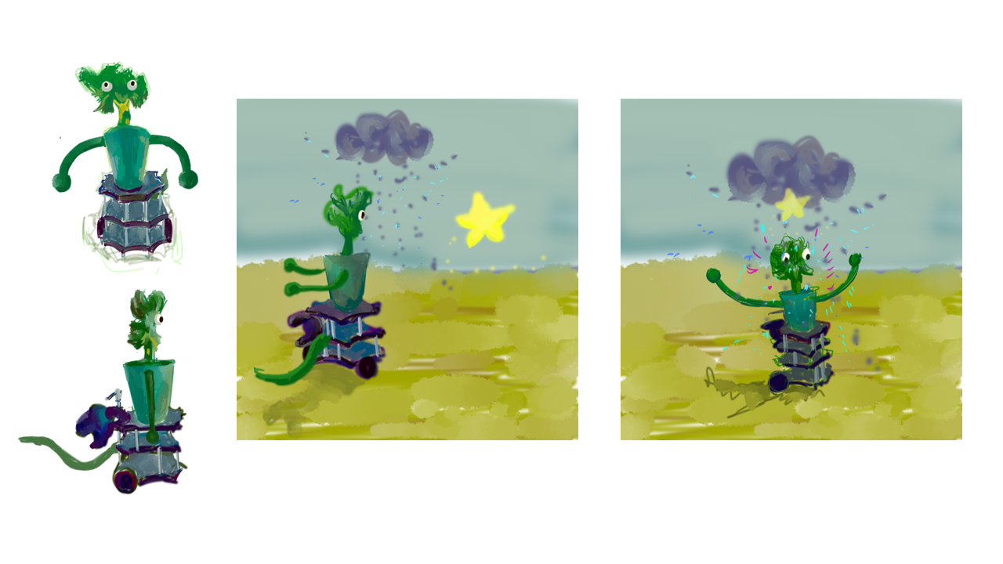
Concept Expansion with Brainstorm
Idea and Concept Generation
Story:
In 2500, there is a high civilization with many Cyborgian agents, and also there is no border between physical and virtual space. Organisms living in this world supported by the robotic body, and most of them are extinct since there are not enough resources in the world……
Now, you are in 2500. The last plant in the world is in front of you. It looses its’ way to the rain, would you like to guide it to the raining area to save its’ life?
Sketch
titles
brainstorm

Slide 3
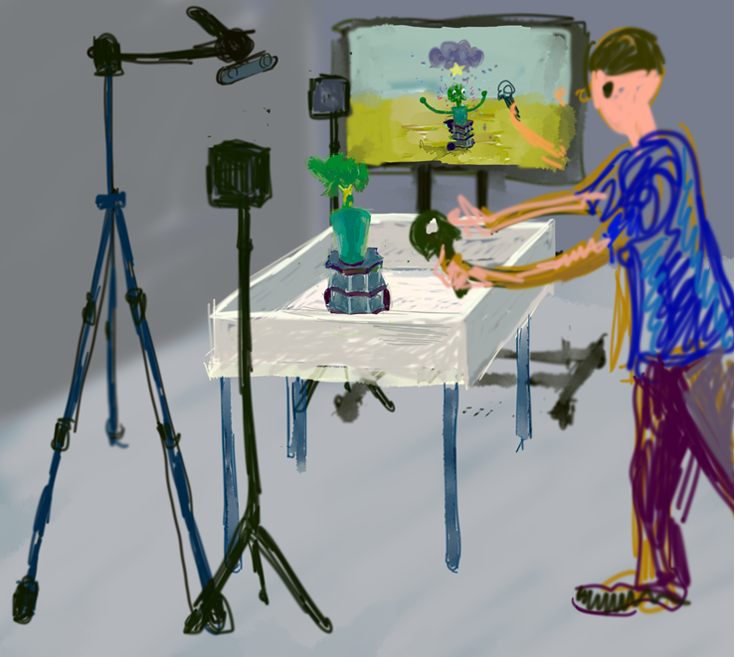
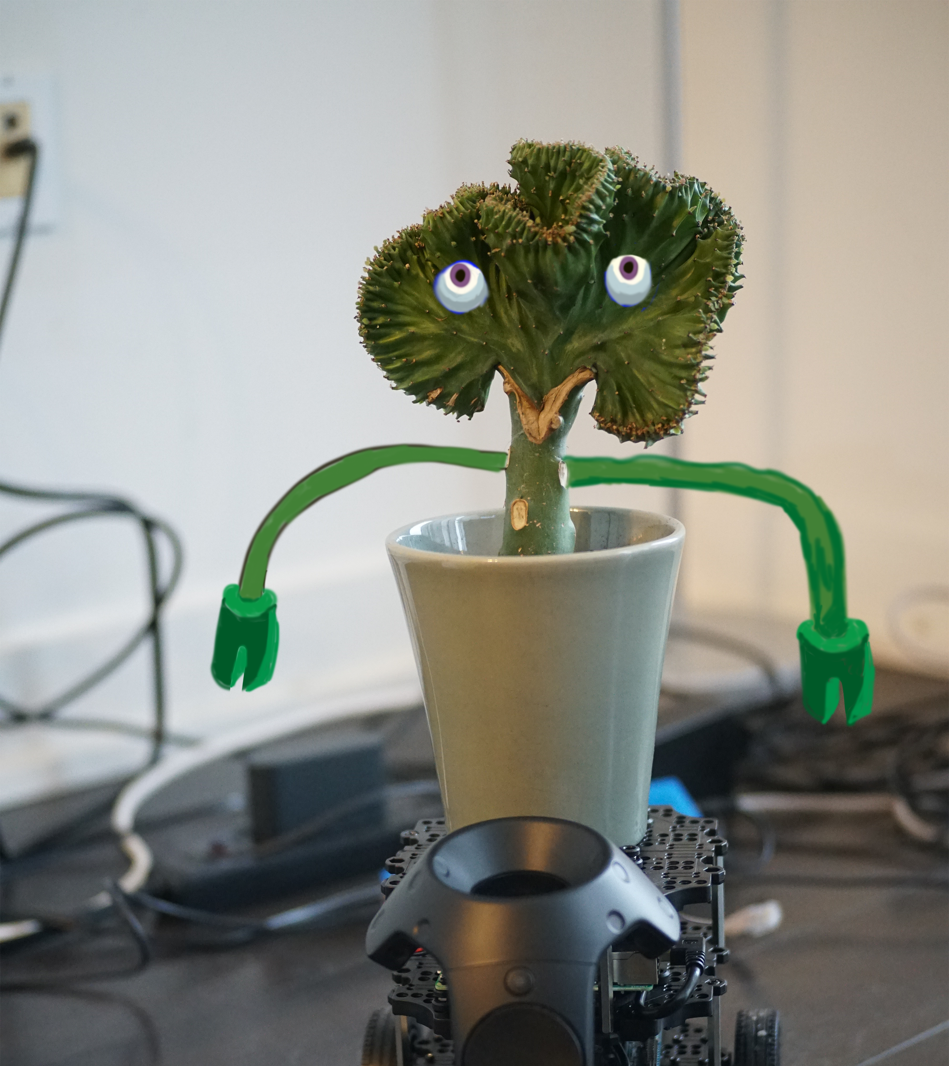
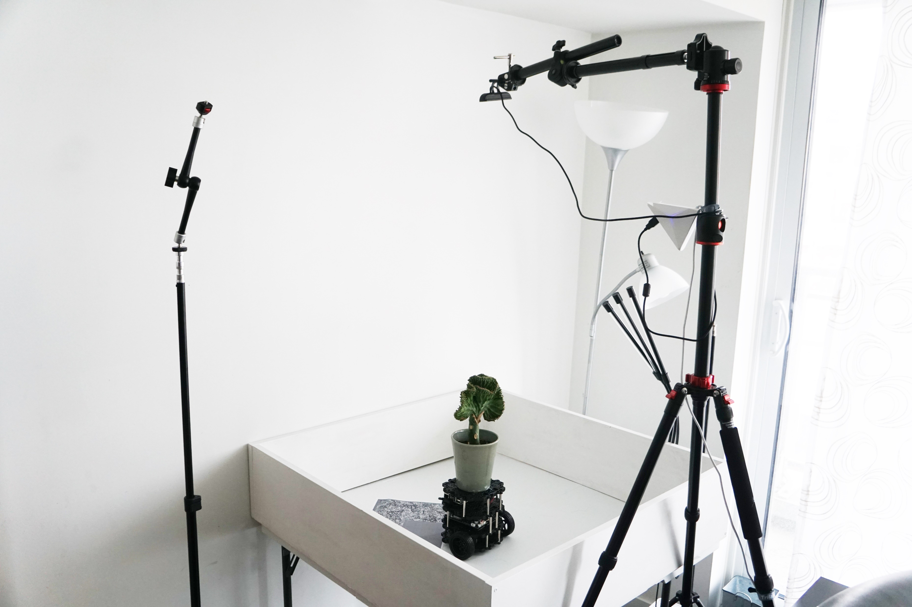
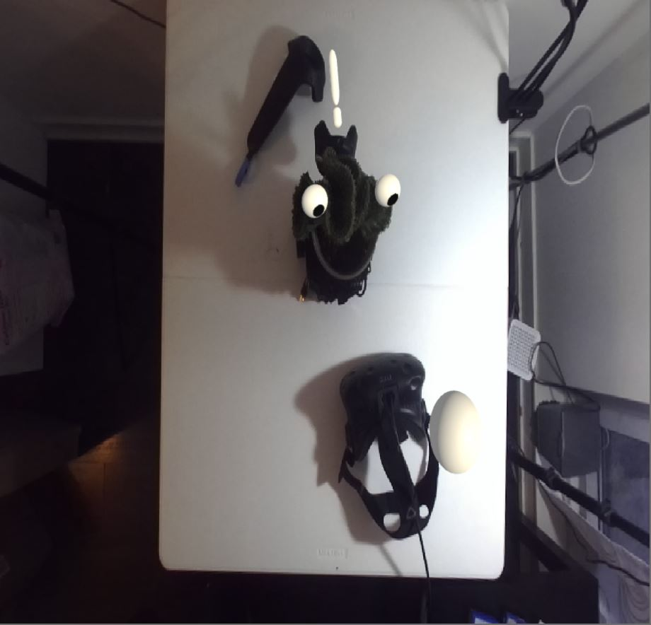
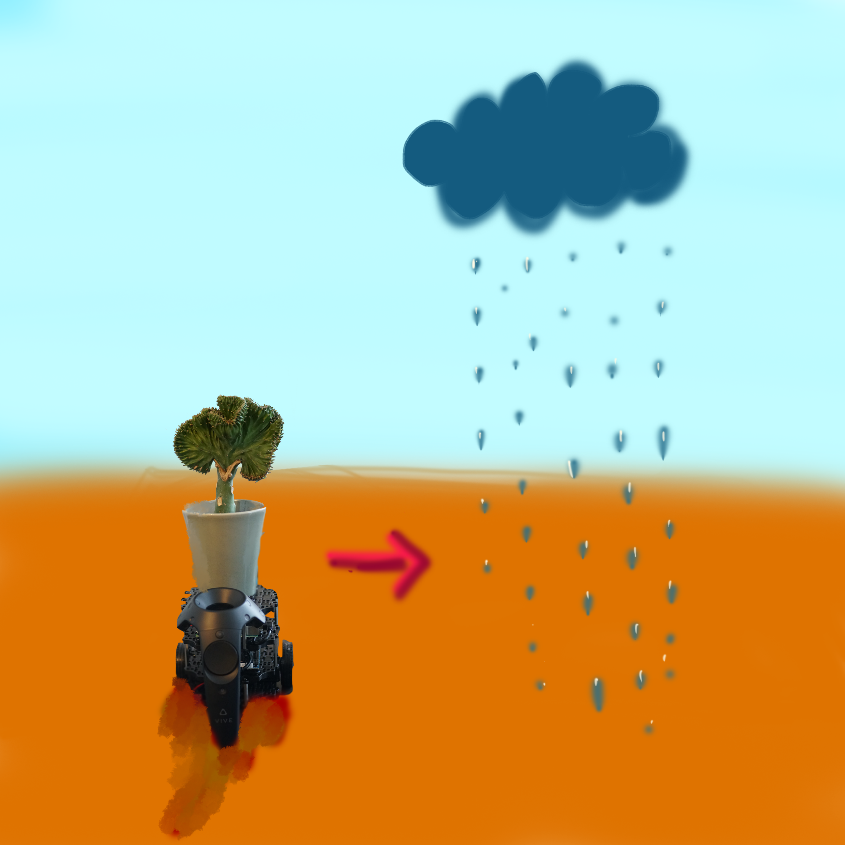
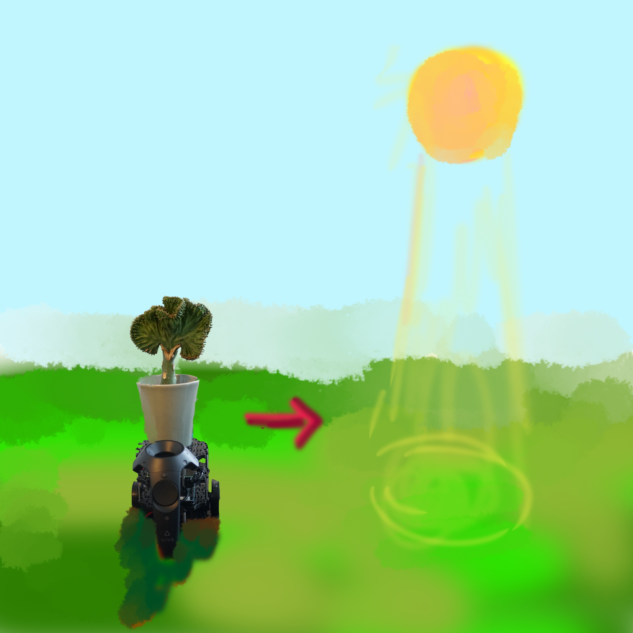
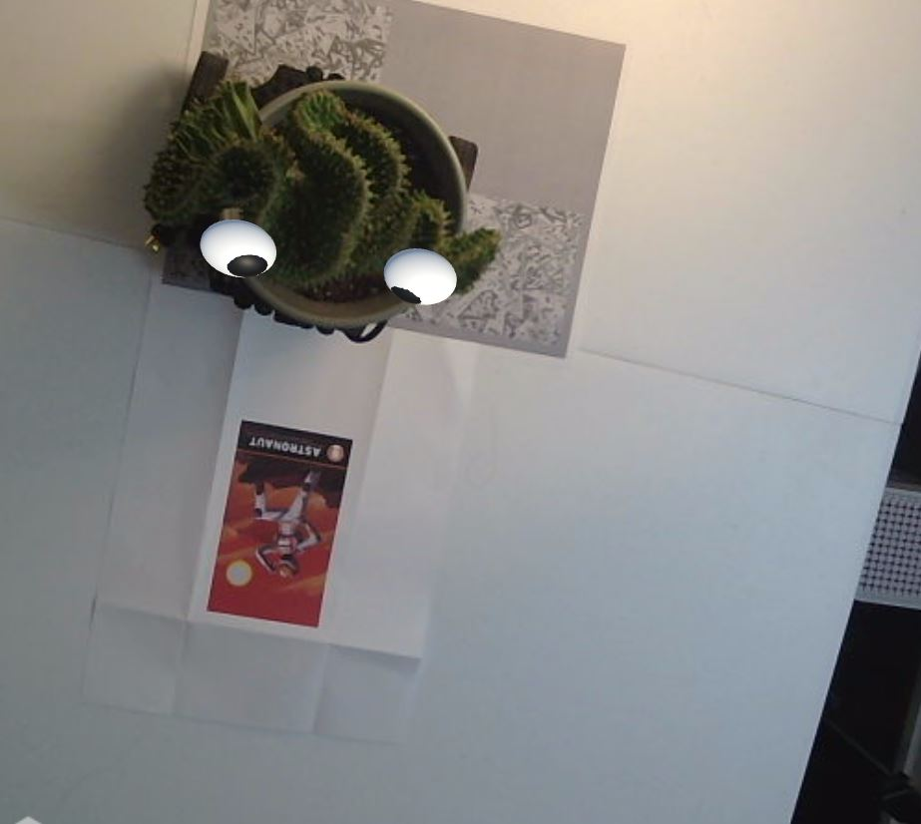
User Scenario
Prototype in Scenario
Storyboard

Slide 4
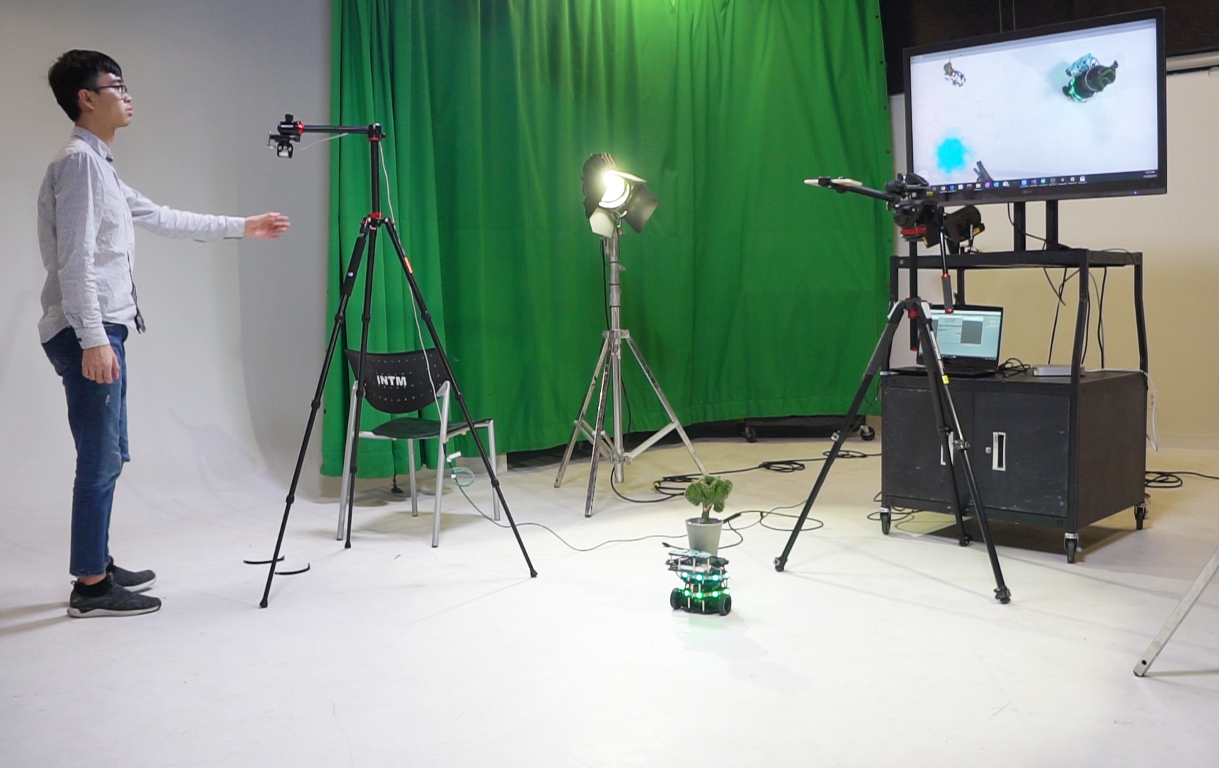
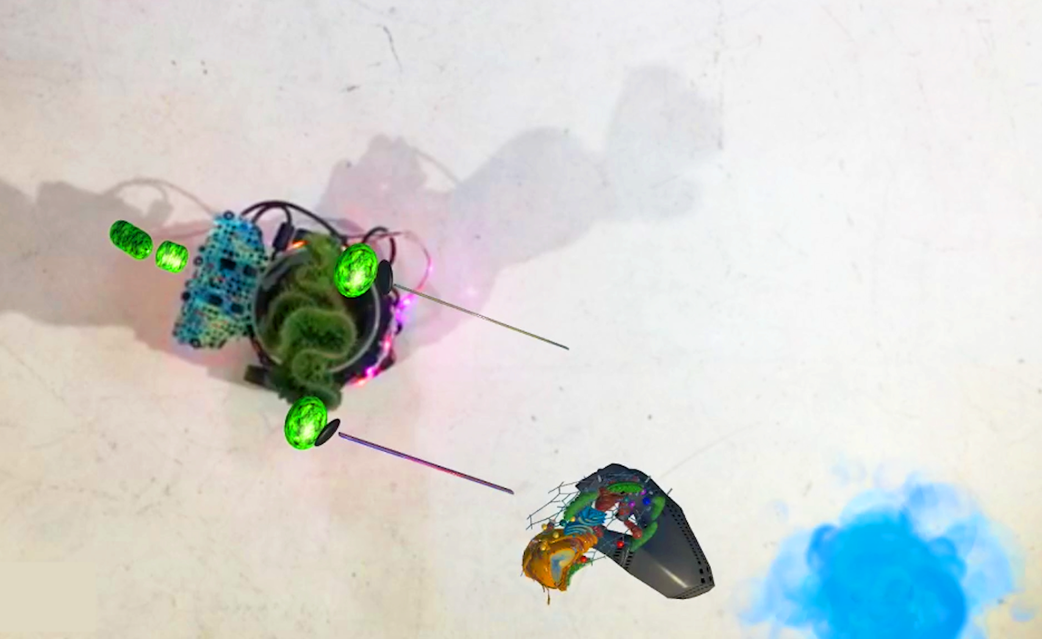
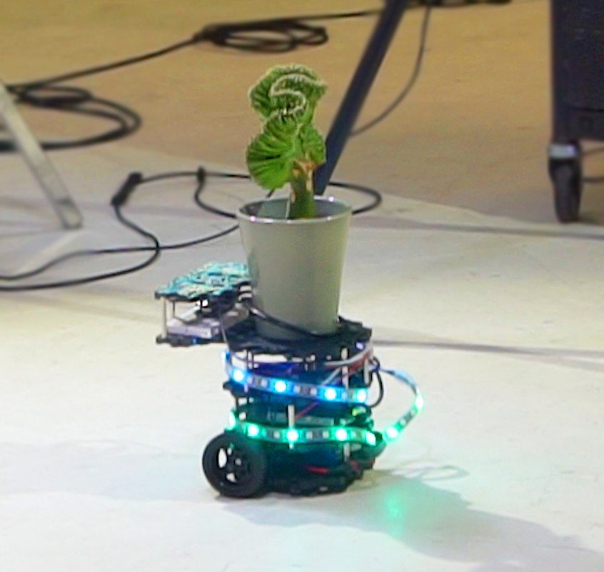
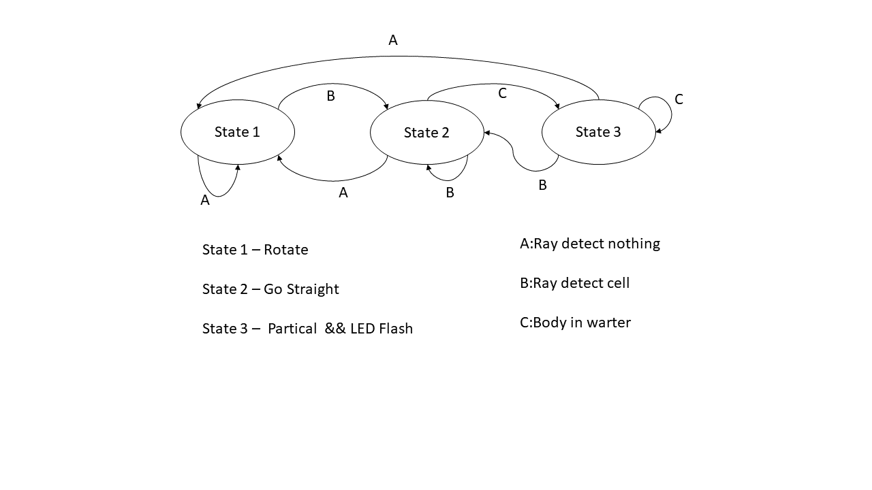
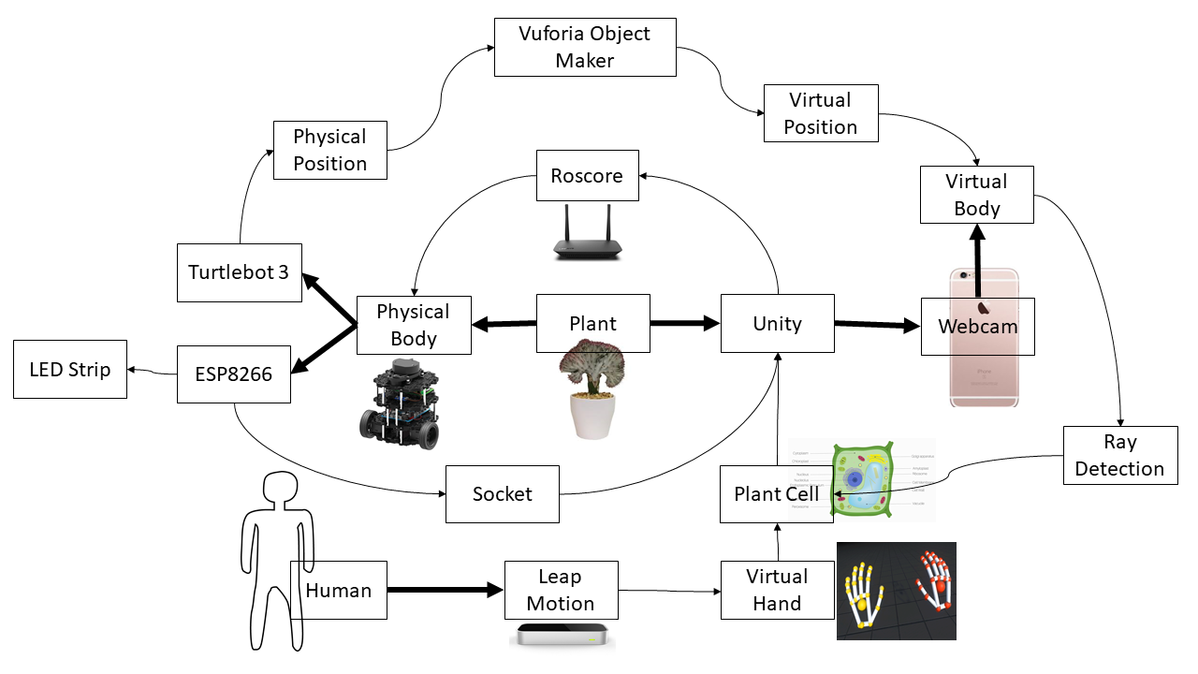
How to Use and Connection
Data Architecture

